Slide 1
Software Testing
Week 1-3
Engr.Bushra Aziz

Slide 2
Software Testing?
Definition:
Software Testing is a method to assess the functionality of the software program. The process checks whether the actual software matches the expected requirements and ensures the software is bug-free. The purpose of software testing is to identify the errors, faults, or missing requirements in contrast to actual requirements. It mainly aims at measuring the specification, functionality, and performance of a software program or application.

Slide 3
Verification and Validation
Software Testing Can be Divided into Two Steps
Verification: It refers to the set of tasks that ensure that the software correctly implements a specific function. It means “Are we building the product right?”.
Validation: It refers to a different set of tasks that ensure that the software that has been built is traceable to customer requirements. It means “Are we building the right product?”.

Slide 4
Importance of Software Testing
Defects can be Identified Early: Software testing is important because if there are any bugs they can be identified early and can be fixed before the delivery of the software.
Improves Quality of Software: Software Testing uncovers the defects in the software, and fixing them improves the quality of the software.
Increased Customer Satisfaction: Software testing ensures reliability, security, and high performance which results in saving time, costs, and customer satisfaction.
Helps with Scalability: Software testing type non-functional testing helps to identify the scalability issues and the point where an application might stop working.
Saves Time and Money: After the application is launched it will be very difficult to trace and resolve the issues, as performing this activity will incur more costs and time. Thus, it is better to conduct software testing at regular intervals during software development.

Slide 5
Need for Software Testing
Software bugs can cause potential monetary and human loss. There are many examples in history that clearly depicts that without the testing phase in software development lot of damage was incurred. Below are some examples:
1985: Canada’s Therac-25 radiation therapy malfunctioned due to a software bug and resulted in lethal radiation doses to patients leaving 3 injured and 3 people dead.
1994: China Airlines Airbus A300 crashed due to a software bug killing 264 people.
1996: A software bug caused U.S. bank accounts of 823 customers to be credited with 920 million US dollars.
1999: A software bug caused the failure of a $1.2 billion military satellite launch.
2015: A software bug in fighter plan F-35 resulted in making it unable to detect targets correctly.
2015: Bloomberg terminal in London crashed due to a software bug affecting 300,000 traders on the financial market and forcing the government to postpone the 3bn pound debt sale.
Starbucks was forced to close more than 60% of its outlet in the U.S. and Canada due to a software failure in its POS system.
Nissan cars were forced to recall 1 million cars from the market due to a software failure in the car’s airbag sensory detectors.

Slide 6
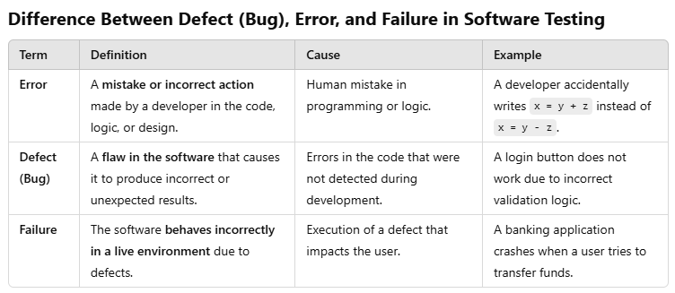
Error, Bugs/Defect and Failure

Slide 7
Error, Bugs/Defect and Failure
Example Scenario:
A developer makes an error in writing a calculation formula in the code.
This error introduces a defect (bug) in the system, which a tester identifies.
If the defect is not fixed and the software is deployed, a customer experiences a failure when they get incorrect results.

Slide 8
Testing Principles
Testing shows the presence of defects: Testing reveals existing issues but cannot guarantee a defect-free system.
Exhaustive testing is impossible: Testing all possible inputs and scenarios is impractical; test case prioritization is essential.
Early testing is beneficial: Detecting defects early reduces the cost and effort required for fixes.
Defect clustering is common: A small number of modules usually contain most of the defects.
The pesticide paradox: Repeated execution of the same test cases will not uncover new defects; test cases should be revised regularly.
Testing is context-dependent: Different software applications (e.g., mobile apps, enterprise software) require different testing approaches.
Absence of errors does not mean the software is useful: The software must also meet user needs and business requirements.

Slide 9
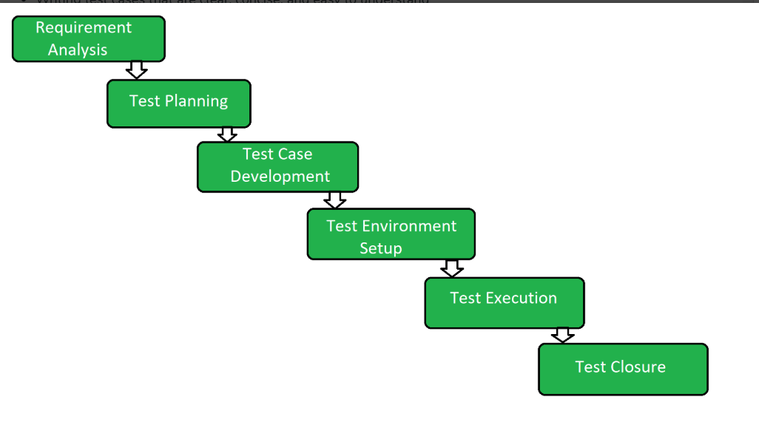
Software Testing Life Cycle
STLC is a fundamental part of the Software Development Life Cycle (SDLC) but STLC consists of only the testing phases.
STLC starts as soon as requirements are defined or software requirement document is shared by stakeholders.
STLC yields a step-by-step process to ensure quality software.

Slide 10
Software Testing Life Cycle Phases
Requirement analysis. During this phase, QA teams collect and document requirements for the software, identify aspects or functionality that can be tested, and determine whether those tests should be manual or automated. Requirements can be functional, relating to specific functions and capabilities, or they can be non-functional, relating to the quality of the user experience and general performance of the application.
Test planning. When planning tests, test managers develop a strategy that documents the steps to be taken, the tools required, and the responsibilities of various people involved in development and testing.
Test case design and development. During this part of the software testing lifecycle, test cases are created by defining test inputs, procedures, conditions of testing, and the expected results. Ideally, test cases aim for 100% test coverage, ensuring that every aspect of the code and its functionality will be covered by the test cases.

Slide 11
Software Testing Life Cycle Phases
Test environment setup. The next step in the testing lifecycle is to configure and deploy testing environments – the actual settings where tests will occur. Test environments include hardware, software, frameworks, configurations, networks, and test data, as well as a variety of testing tools.
Test execution. During execution, tests cases are run within the test environment, and testers compare actual results to expected results. Findings are documented for reporting back to development teams.
Test cycle closure. Reports document the steps taken in the testing process and the results or findings of tests, including any defects that were discovered in the process. Reports compare the results of tests to the software requirements identified in the initial phase of testing.

Slide 12
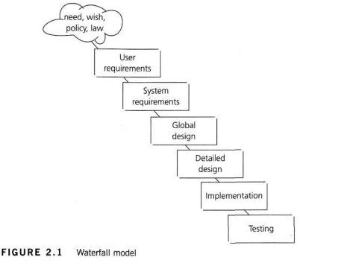
Software Development Models and Testing Approach
Waterfall Model:
Each phase (Requirements, Design, Implementation, Testing, Deployment, Maintenance) is completed before the next begins.
Testing Approach: Testing is done only after the development phase is complete.
Challenges: Late-stage defect detection, higher cost of fixing defects.

Slide 13
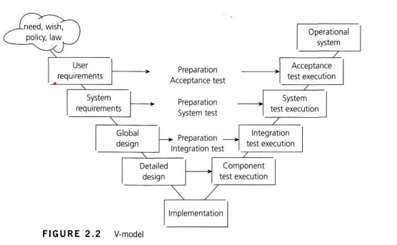
Software Development Models and Testing Approach
:V-Model:
Each development phase has a corresponding test phase (e.g., Unit Testing for Coding, System Testing for System Design).
Testing Approach: Verification and validation happen in parallel with development.
Benefits: Early defect detection, better requirement validation.

Slide 14
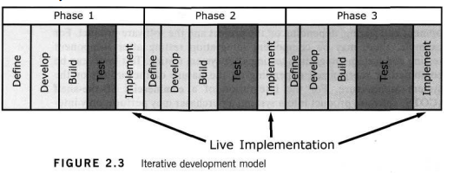
Software Development Models and Testing Approach
Iterative and Incremental Models:
Software is developed in small parts (increments) with iterative cycles.
Testing Approach: Testing occurs at the end of each increment, allowing early feedback and defect resolution.
Advantages: Defects are addressed in earlier stages, reducing costs.

Slide 15
Test Levels
Unit Testing:
Tests individual modules or components.
Performed using white-box techniques.
Integration Testing:
Ensures different modules work together.
Top-down, bottom-up, and big-bang approaches.
System Testing:
Validates the entire system’s functionality.
Includes performance, security, and usability testing.
Acceptance Testing:
Verifies software readiness for deployment.
Includes User Acceptance Testing (UAT) and Operational Acceptance Testing (OAT).

